Slide 1
Building an End-to-End Digital Recall Network
Digital Recalls

Slide 2
Agenda
Why digitalizing the recall management process is essential for pharmacy leaders
The recall process today and how it falls short of your needs
Empowering better recall management with TraceLink’s Digital Recalls
TraceLink is your recall management transformation partner
Digital Recalls is a major step forward to achieve an end-to-end digitalized recall network

Slide 3





































TraceLink is the Largest End-to-End Digital Network for the Healthcare & Life Sciences Industry
2009
6
800
290K+
Year Founded
Global Offices
Employees
Total Network Members
1,500+
Total Customers
51
Countries with Customers
Life Sciences Manufacturing
Distribution & Logistics
776 Customers | 1,816+ Partners
Contract Manufacturers & Packagers
64 Customers | 870+ Partners
149 Customers | 850+ Partners
348M+
Transactions Processes
339K+
Active Network Links
$4.4B+
P2P Integration Customer Savings
Healthcare & Pharmacy
Direct Materials Suppliers
301 Customers | 249K+ Partners
1,682+ Partners
37.6B+
1B+
47K+
Product Units
Advance Shipment Notices Processed
Unique Product Codes
Notes:
Add number of B2B transactions!

Slide 4










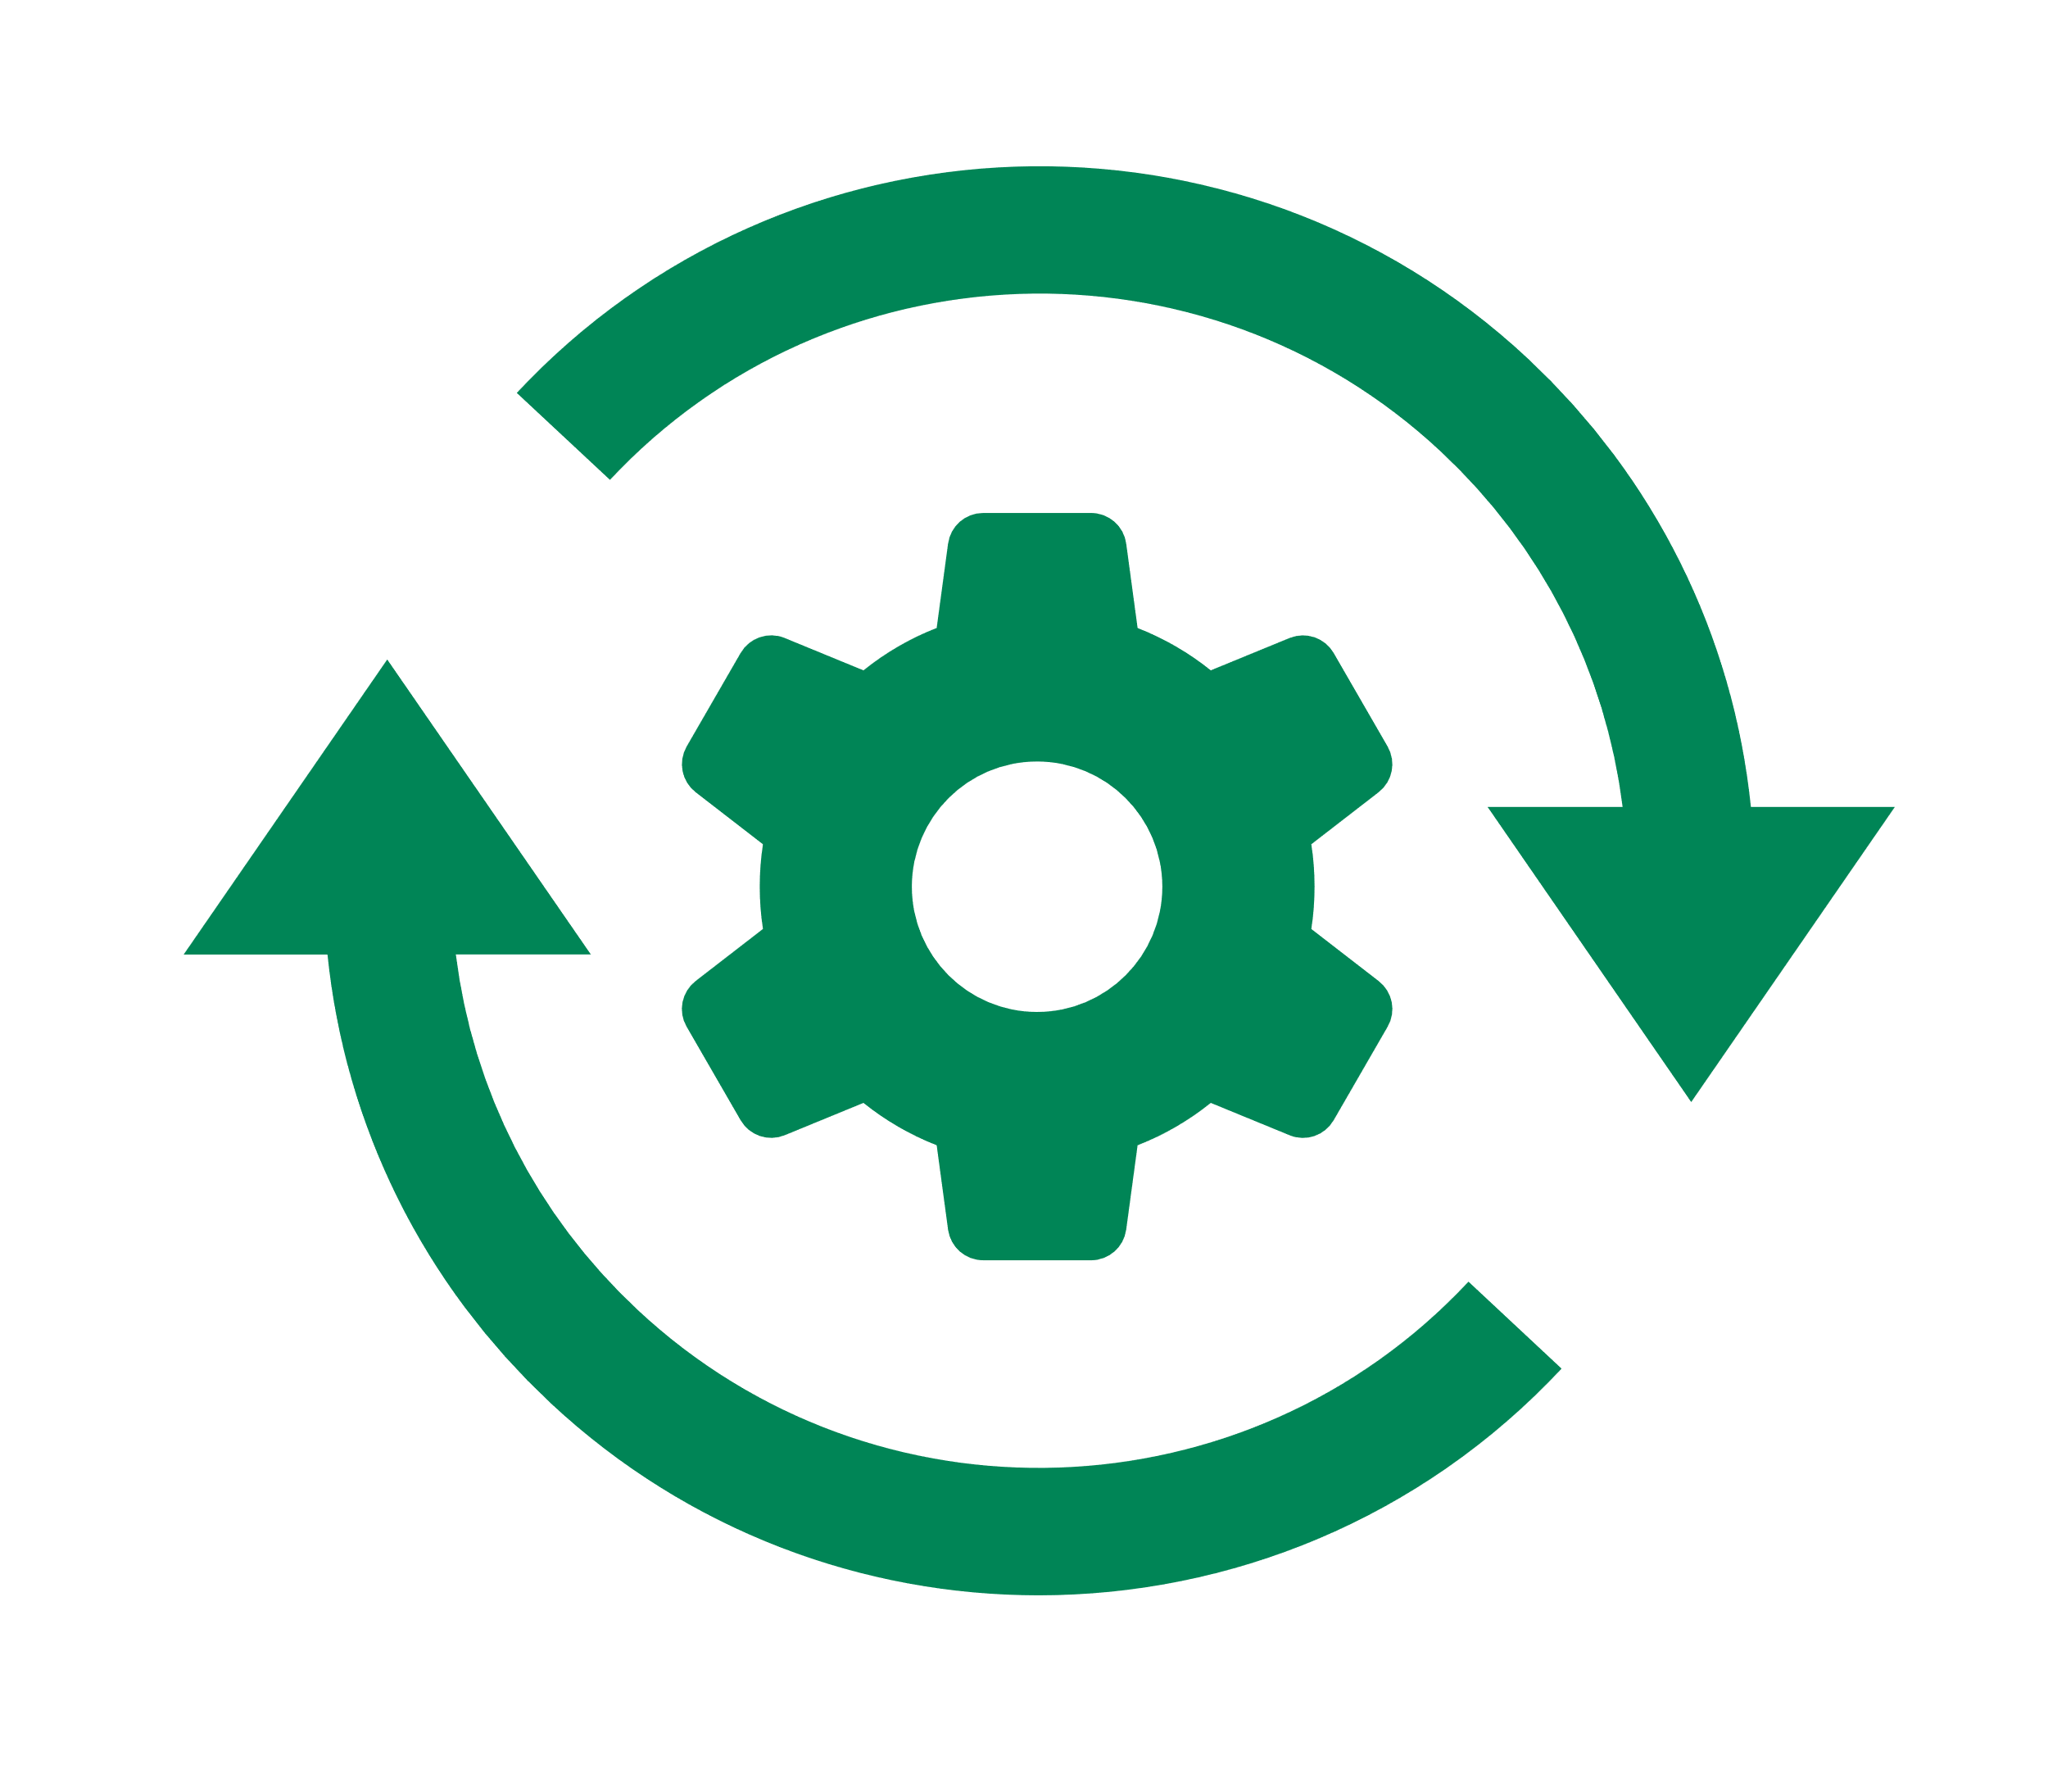














End-to-End Digitalization on an Intelligent Industry Network
Collective Intelligence
Transparency
Predict Drug Shortages 90 days in Advance with 90%+ Confidence
Product Availability & Recalls
Customers
Retail & Services
End-to-End Orchestration
Wholesale Distributors
Orchestrate Cell & Gene Therapy, Digital Recalls, Product Supply, and Trading Partner Work Management
3PLs
Material / Component Manufacturers
End-to-End Supply Chain Information & Visibility
Integrated Visibility Across All Trading Partners and All Transactions (Commerce, Logistics, Inventory, etc.)
Contract Manufacturing
Organizations
Contract Packaging
Organizations
End-to-End Track & Trace
Manufacturers
Guaranteed Support for All Global Compliance Mandates
End-to-End Network
Integrate-Once Network Managed by TraceLink Reduces Time and Cost by 10x
Collective Platform
Collective Orchestration
Collective Intelligence

Slide 5





Why digitalizing the recall management process is essential for pharmacy and supply chain leaders
Recalled drugs can reach your patients and threaten their wellbeing
Organizations need standardized operating processes to maintain compliance
Recalls disrupt operations by creating work that warrants immediate attention
The process for receiving returned product credits is opaque
Drug recalls aren’t your fault, but they have big implications that warrant a modern solution.
Recalls create drug shortage risks due to drugs being removed from the supply chain
Notes:
Anecdote:
A cross-industry, cross functional team of industry leaders from each segment of the US. Supply chain collaborated for six months in 2019 under the FDA Pilot Project Program to study analyze and prepare recommendations on how to improve the drug recalls process for all stakeholders.

Slide 6








The current recall management process is manual, time consuming, labor intensive, and prone to human error
Tight deadlines to contact patients
Vulnerability to notification delays
What we heard from our Pilot program:
Too much time and effort filtering recall “noise”
Need to determine which recalls impact the organization
Manual response tracking to maintain compliance
Too much time and effort coordinating and organizing responses
Overloaded recall backlog every single day
Siloed communication between corporate and sites
Too much time and effort tracking effectiveness
Lack of visibility into monitoring recall response progress company-wide

Slide 7
Your Recall Process Today?
Notification Sources (electronic, snail mail, portals, paper)
Recall Support Team/Recall Coordinator/Site Responder
Receipt of recall/Impact assessment/Recall initiation
Identify impacted items
Look up purchase history, Shelf walk, pull product
Recall response internally & externally
Product return/destruction, Reimbursement
Recall Monitoring and Closeout

Slide 8
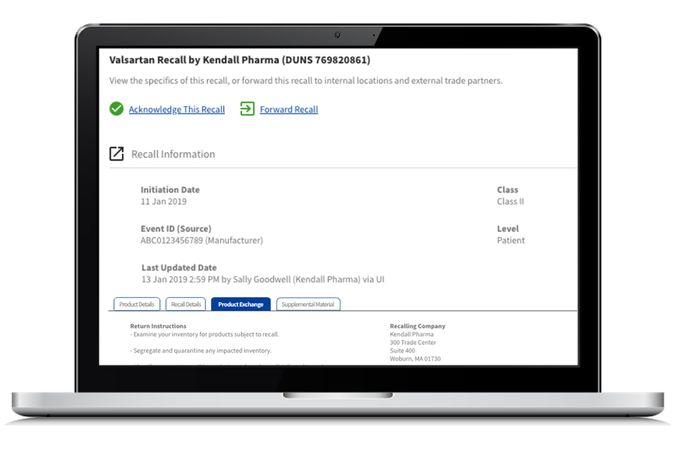
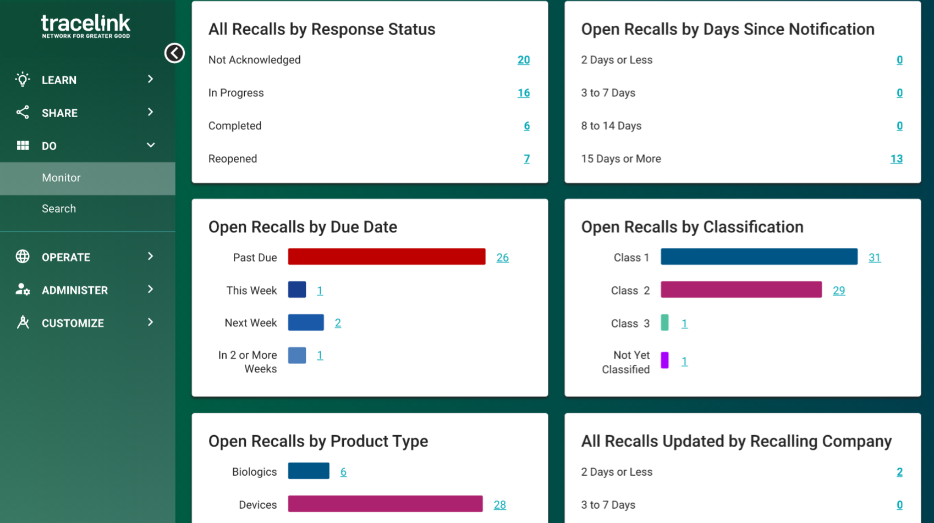
Digital Recalls
View digitalized recall notifications, acknowledge and provide location-level inventory responses, track effectiveness across the organization, and maintain a digital audit trail.
Key Capabilities
Real-time recall notifications in an easy-to-understand digital format
Orchestrated workflow across sites for recall acknowledgment, response gathering, monitoring, and collaboration
Digital audit trail to prove adherence to recall response plan and support regulatory compliance
Integration with DSCSA Compliance Track & Trace solution to create targeted recalls; receive recall notification only for products the organization has purchased
Dashboards for simple, comprehensive ability to monitor by product, progress, and sites
Customer Benefits
Free up skilled pharmacy staff so they can focus on patient care
Increase patient safety by removing opportunities for human error
Decrease costs associated with managing a recall
Expedite recall response and product removal from inventory and faster reimbursements
Notes:
Challenge: Recalls are time consuming for pharmacy staff and threaten patient safety
Note: A cross-industry, cross functional team of industry leaders from each segment of the US. Supply chain collaborated for six months in 2019 under the FDA Pilot Project Program to study analyze and prepare recommendations on how to improve the drug recalls process for all stakeholders.

Slide 9









Orchestrate recall workflow in a shared digital space
TraceLink’s Digital Recalls Notifications Service
TraceLink’s Digital Recalls Work Management
TraceLink’s network team digitalizes recalls routed from the FDA. New recalls, and updates to existing recalls, are uploaded in real time
Dispensing sites submit acknowledgement of the recall, opt in if impacted, and provide details like the quantify of the recalled product that was found
Central pharmacy leader logs into TraceLink to monitor responses across the organization. Individual recall responses can be approved, or a request can be made for corrective action
FDA Notification
Central Pharmacy Leader
Dispensing Site
A
Dispensing Site
B
Dispensing Site
C
Notes:
TraceLink sources recalls, safety alerts, and market withdrawal notices from the FDA to receive automatic updates.
Recalls sourced from FDA Safety Alerts and FDA Enforcement Reports and digitized/published into PIM w/ approval step;
Publish-Subscribe model
->PIM–>PIE–>SCWM/APT
PIM<-PIE<-SCWM/APT
TL customers need PIE, SCWM/APT App and Company Master Data (TL will create location-level links then will assign users to location(s)
TL customers ‘subscribe’ to recalls (Device, Drug, Biologics, Vet)
Application Opus Digital Recalls
Additional application for Targeted Recalls (Opus US Compliance)
Additional DR Manager will be the bridge between these two.

Slide 10
Recalls Workflow
Inventory?
Add Recall
Opt Out
Acknowledge
Comment
Comment
Gather
Monitor
Track
Record
Administer/ Coordinate
TraceLink
Approve? (optional)
Recall Coord
Site / User
Notes:
Subscribers can use the new Recalls process to view the details of a recall issued by the FDA…. and submit an acknowledgment, record quantities, and provide completion responses for each of their locations in TraceLink.
publish-subscribe model
TL Workflow:
Recalls sourced from FDA Safety Alerts and FDA Enforcement Reports and digitized/published into PIM w/ approval step;
Additional Recall sources are being explored.
TL manufacturers sourcing/entering recalls direct-on roadmap.
Then all relevant recall customer locations are alerted. In the future this will be based on a match with received compliance data from your suppliers that TraceLink receives and stores.
Once the recalls are assigned, they will appear on the dashboard for each location and its parent company
Customer Workflow:
Administrators/Recall Coordinators will have the ability to assign recalls, monitor recalls, send out reminder notifications and track the overall status of a recall for all their locations.
Customer location Onsite Responder workflow:
Customer receives alerts for their locations. Click on alert to open and review Recall details.
Opt out or Acknowledge
If Ack, then gather: walk shelves/check inventory locations and pull product
Impacted? Answer yes/no for impacted then if yes, enter quantity(ies) for each product in recall.
.
If so, the location can acknowledge the recall …
….or if they don’t buy that product, they can “opt out”
….the dashboards will auto-update
Assuming it does have inventory, they can pull the product from the shelves/cabinets
….and record it in TraceLink.
Enabling each of your locations to opt out, or submit recall responses, allows them to quickly and effectively determine how a recall impacts them and communicate that impact to the rest of your team/organization. This reduces the time and effort required to respond to and manage recalls.
Of course, if there are any questions both the administrator and the sites can comment on each recall specific to that location.
Your company has the option so that once the inventory is pulled, the location can submit the response to the Administrator for final approval.
…either way, it updates the dashboard
Now let’s see that in action

Slide 11







TraceLink’s Digital Recalls leverages an integrated set of digital capabilities for next-gen, end-to-end recall management
Digital Recalls Capability:
Business Impact:
Real-time recall notifications in an easy-to-understand digital format
Reduce days required to initiate product search by 30%
Collaborative workflow across sites via a shared digital solution
Reduce administrative workload by 40% by leveraging a coordinated process
Digital audit trail of end-to-end Digital Recalls process
Eliminate manual recordkeeping needed to prove recall plan adherence
Single digital solution for all exception and work management
Consolidated solutions in one familiar platform

Slide 12


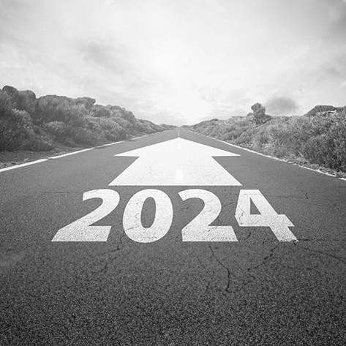





Digital Recalls will unlock value in compliance-driven investment by leveraging serialization data mandated by DSCSA 2023
Digital Recalls Future Capability:
Business Impact:
Reduce the number of shelf walks by 47% by only searching for product your organization has purchased
Targeted recall notifications
Locate recalled products 35% faster by supporting inventory location management
Integration with TraceLink’s DSCSA compliance Track and Trace Solution
API integration with medication management systems
Save time an effort by automating data entry with connected systems
Reimbursement based on serialized reconciliation
Get more value for your returns with enhanced transparency
Notes:
Future: Provide more accurate credits for returns

Slide 13





Digital Recalls will integrate with TraceLink’s Track & Trace solution and medication management systems
TraceLink matches DSCSA purchase data to the recall database to create “targeted” recalls
Organization gets alerted for recalled product that they have purchased
API integration with medication management systems enables product visibility as it moves throughout the dispensing site
DSCSA Purchase History
Medication
Management System
Recall Database
Targeted Recall Notification

Slide 14

TraceLink’s Digital Recalls enables better business outcomes and patient care.
Digital Recalls improves patient safety. Recalled product will be removed from the supply chain faster, reducing the risk it reaches consumers.
Digital Recalls supports organizational efficiency. The reduction in labor needed to coordinate recall responses and keep records gives time back to your organization.
Digital Recalls promotes product availability. Reacting faster to recalled product removal gives organizations a jump start on replenishing inventory or planning alternative treatment.
Digital Recalls supports regulatory compliance. Recordkeeping is paramount, and the digital audit trail tracks an organization’s recall responses automatically.

Slide 15


TraceLink is your trusted recall transformation partner
Full-Service Onboarding
Training and Support
Proven Partner for Dispensers
Startup support to ensure smooth transition to digital recall management
Regular training via webinars and informative videos for asynchronous support
300+ dispenser customers part of the TraceLink Network
TraceLink’s Professional Services and Healthcare Operational Services Team (HOST) provides you dedicated support.

Slide 16





Case Study: Digital Recalls frees up skilled full-time employees
Work Management value:
Company profile:
Site admin hours per week | 4.16
Digital Recalls admin time saved | 25%
Site admin hours saved per week | 1.04
Site admin hours saved per year | 52
FTE admin equivalent created | 1.9
74-site health system
4.16 hours spent per week at each site orchestrating recalls
9.3 hours spent per week at each site walking shelves
Targeted Notifications value:
Result: 10.5 FTE of skilled labor freed to focus on serving patients
Site technician hours per week | 9.3
Digital Recalls shelf walk reduction | 50%
Site technician hours saved per year | 233
FTE technician equivalent created | 8.6
Digital Recalls Price: $52,000
Notes:
Drive home that the admin person could be someone who is very senior and in high demand, short on time, could be a director-level, could be in IT.
When a recall hits, everything pauses so they can respond immediately. Drive home what functions they are dropping to respond to the recall. What important stuff were they doing before, that now is on the backburner.

Slide 17

TraceLink Digital Recalls - Subscription Pricing Model
Digital Recalls Notifications + Supply Chain Work Management
Tier 1
Tier 2
Tier 3
Custom Price
Number of Pharmacy Sites | 1 – 3 | 4 – 50 | 51 – 100 | >100
Annual Cost per Pharmacy Site | $0 | $800 | $600 | Contact Us
Pricing Model Features
No cost for organizations with three or fewer pharmacy sites
Regressive pricing for larger organizations
What’s included? 1 Digital Recalls Notifications license + 1 Supply Chain Work Management user license per site
Want more users? Purchase additional Supply Chain Work Management user licenses using the same tier-based model
Pricing Checklist
How many pharmacy locations will use Recalls?
How many total users will use Recalls?
Example: Health system with 30 pharmacies and 60 total users
Total cost = (3 x $0) + (47 x $800) + (10 x $600) = $43,600
Tier 1
Tier 2
Tier 3

Slide 18
Digital Recalls for dispensers is a major step forward to achieve an end-to-end digitalized recall network
2023
2024
2025
Digitalized recall notifications
Unified work management
Digital audit trail
Integration with track and trace solution
Targeted recall notifications
API integration
Shared digital space with MAHs
Recall notifications direct from MAH
Fully closed-loop, end-to-end recall network throughout the entire supply chain

Slide 19
Next Steps
Proposed Next Meeting: Deep dive into process and challenges
Meeting Goals:
Workshop to understand your current recall process
Discuss use case
Business discussion
Solution demo
Time Needed: 45-60 minutes
Recommended Attendees: Pharmacy Operations, Recall Coordinator
TraceLink Follow-Up: We will share today’s materials with you for internal review

Slide 20
Appendix

Slide 21





Digital Recalls Self-Led Training
Contract Signed
Ongoing Recalls Notification
Data Collection
System Setup
User Access
#
#
#
Customer signs contract for Digital Recalls
TraceLink sends Welcome email
TraceLink publishes Recalls service
Professional Services works with customer to assign a user to each location
Professional Services setups Digital Recalls services for each location
Professional Services enables email notifications of ongoing recalls for users
Professional Services sends training material to Customer
Customer receives emails for ongoing recalls
Customer reviews recalls notices details in application
Customer responds to recall (optional)
HOST services to support question/issues
1
2
3
4
5
Onboarding Timeline: within 24 hours of receiving Customer’s user location form
Implementation Cost $0

Slide 22
Digital Recalls Instructor Led Training
Contract Signed
Data Collection and System Setup
Recall Process Review
Ongoing Recalls Management
User Access
#
#
#
Customer signs contract for Digital Recalls
TraceLink sends Welcome email
TraceLink publishes Recalls service and works with customer to set up a user for each location
Professional Services setups Digital Recalls discovery session with Customer
Customer reviews and updates recall SOP
Professional Services trains customer on Digital Recalls Work Management
Professional Services works with Customer on first two recalls
Customer responds to recalls and gets centralized view of recall actions.
HOST services to support and question/issues
1
2
3
4
5
Onboarding Timeline 20-45 Days
Implementation Cost: Tier 1-2 $1,500, Tier 3-4 scoped separately

Slide 23
TraceLink’s Alerting System Provides Coverage and Reliability
Drugs
Biologics
Medical Devices
Veterinary
Prescription
OTC
Compounded drugs
Investigational drugs
Any product classified as a drug by the FDA for human use
Vaccines
Blood products
Implantable devices
Diagnostic devices
Therapeutic devices
Supply products
Animal vaccines
Feed additives
Medicated feed
Pet food and treats
Livestock feed
Biologics for veterinary use
TraceLink sources recalls, safety alerts, and market withdrawal notices from the FDA to receive automatic updates.
Notes:
A recall is an action taken by a manufacturer to remove a product from the market when it is found to be defective or potentially harmful.
A safety alert is promoted by the FDA on behalf of a manufacturer to provide information about a product that may pose a risk to public health.
A market withdrawal is a voluntary action taken by a manufacturer to remove a product from the market when there is a minor violation that would not be subject to FDA legal action.
TraceLink’s primary source of recalls is the FDA Enforcement Report, which publishes recalls that have been classified, or are awaiting classification, by the FDA. New recalls, and updates to existing recalls, are published every day.
Recalls sourced from FDA Safety Alerts and FDA Enforcement Reports and digitized/published into PIM w/ approval step;
Publish-Subscribe model

Slide 24





Dedicated Dispenser Support - Healthcare Operations Services Team (HOST)
Full-Service Supplier Onboarding
Manage Supplier Outreach and Onboarding
Manage Supplier Connection Support/Issues
Ongoing Support to Add New Suppliers
User Admin Support
Add / Remove User Access
Add / Update Company Locations
Audit Support
Audit Prep Support
Provide Live Phone Audit Assistance
Provide Audit Data Extracts
Training and Community
Regular Training Sessions
Community Access Providing Industry Updates
Full Online Training Library
Proactive Transaction Monitoring
Proactively Monitor and Correct Transaction Errors

Slide 25
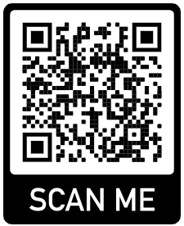
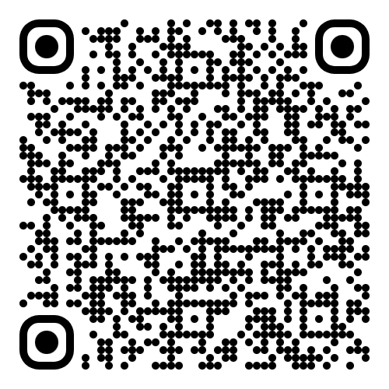
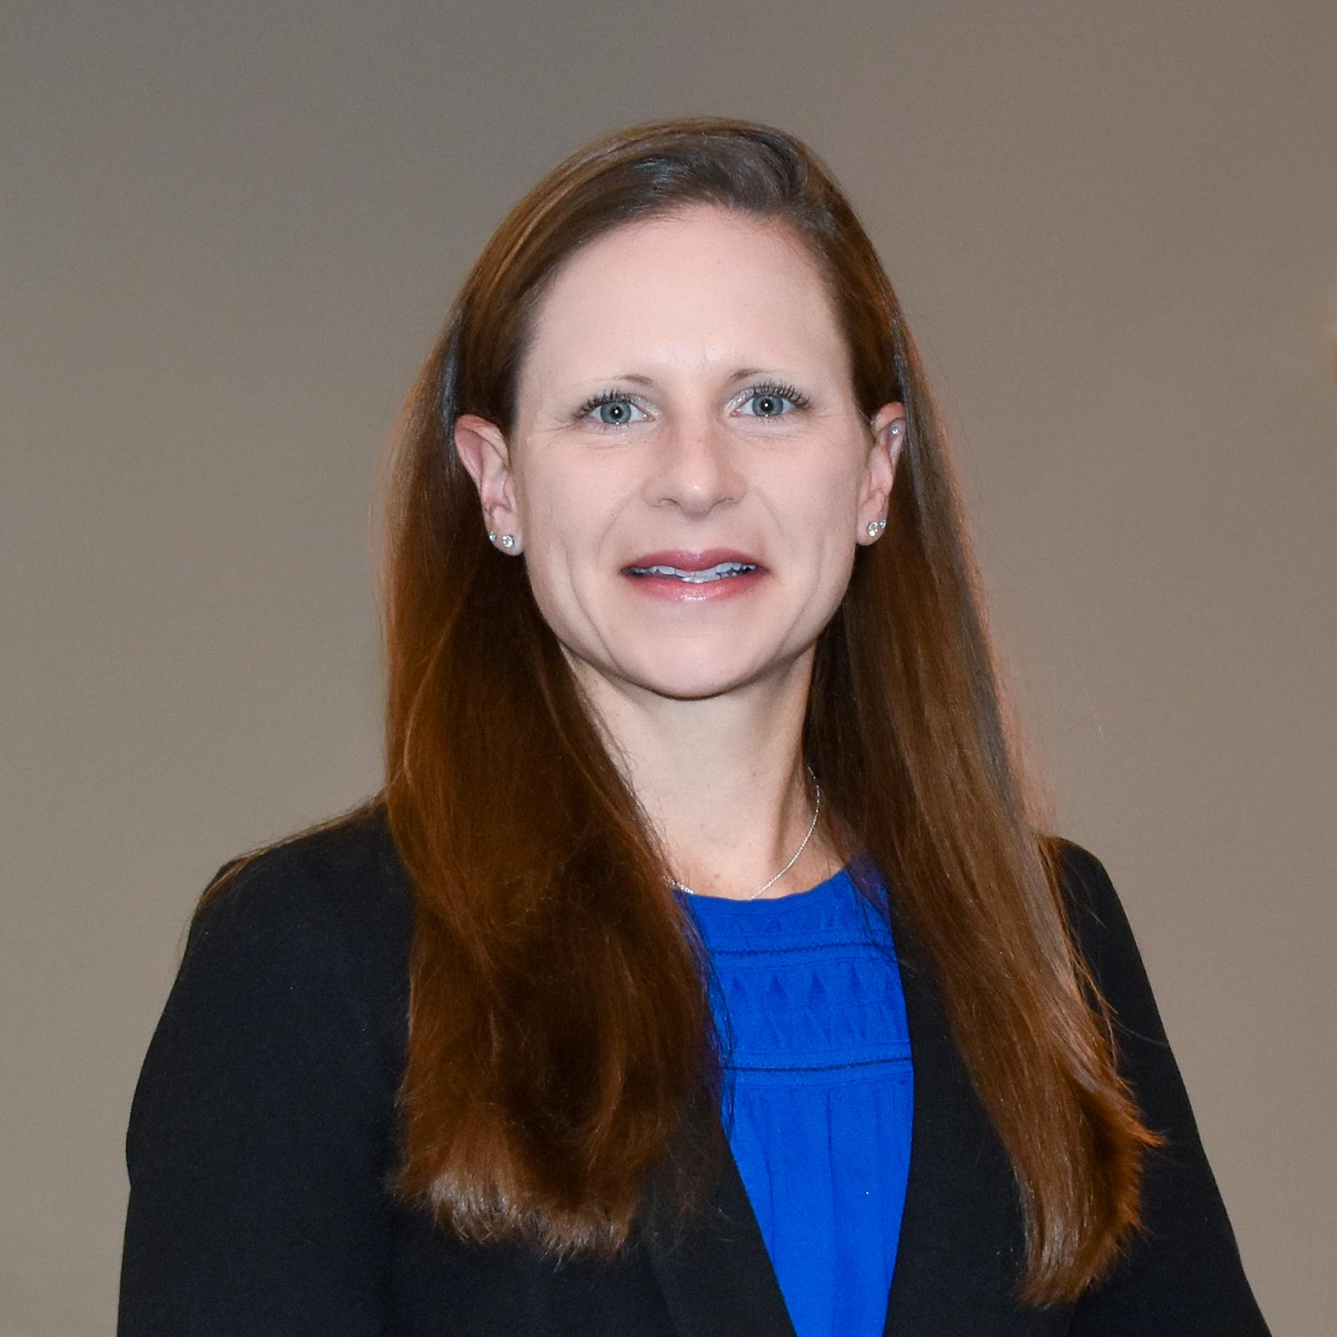
Join TraceLink’s DSCSA Dispenser Community
TraceLink’s DSCSA Dispenser Innovation Forum offers its members unparalleled access to industry updates, compliance education, and peer feedback to help you prepare successfully for the sweeping changes coming into effect in November 2024.
Join now to:
Gain confidence in implementing the DSCSA’s dispenser-focused requirements to free up time to serve patients
Understand legal obligations as well as interoperability standards that will allow you to operate seamlessly with other trading partners and to respond to requests from regulatory authorities
Exchange knowledge with, and ask questions of, peers on how other pharmacies and healthcare systems are operationalizing changes in compliance requirements within their organizations
Develop your action plan through topics such as Exceptions Management, Managing Suspect and Illegitimate Product, and using the right TraceLink applications for your business
Monthly, 50-minute meetings
Third Thursday of the month at 11am EDT
Host Erica Sievert, PharmD is a licensed pharmacist with over 10 years’ experience in managing pharmacy operations. Send your question or topic to community@tracelink.com.
Notes:
In addition to providing a review of the 2023 requirements, other topics include:
A Review of TraceLink’s product roadmap ensuring readiness for 2023
Understanding from other members and from TraceLink’s experience various compliance strategies organizations can develop
Exception Management - what are the other dispensers doing?
Managing Suspect & Illegitimate Product Verification - what’s c

Slide 26
Digital Recalls Solution User Experience
Notes:
opus.tracelink.com
Recall Coord: scdemo+admincounty@tracelink.com pwd/LastPass shared acct.
Onsite Responder: scdemo+recall@tracelink.com pwd/LastPass shared acct.
Network: US Distrib
Process: Recalls

Slide 27
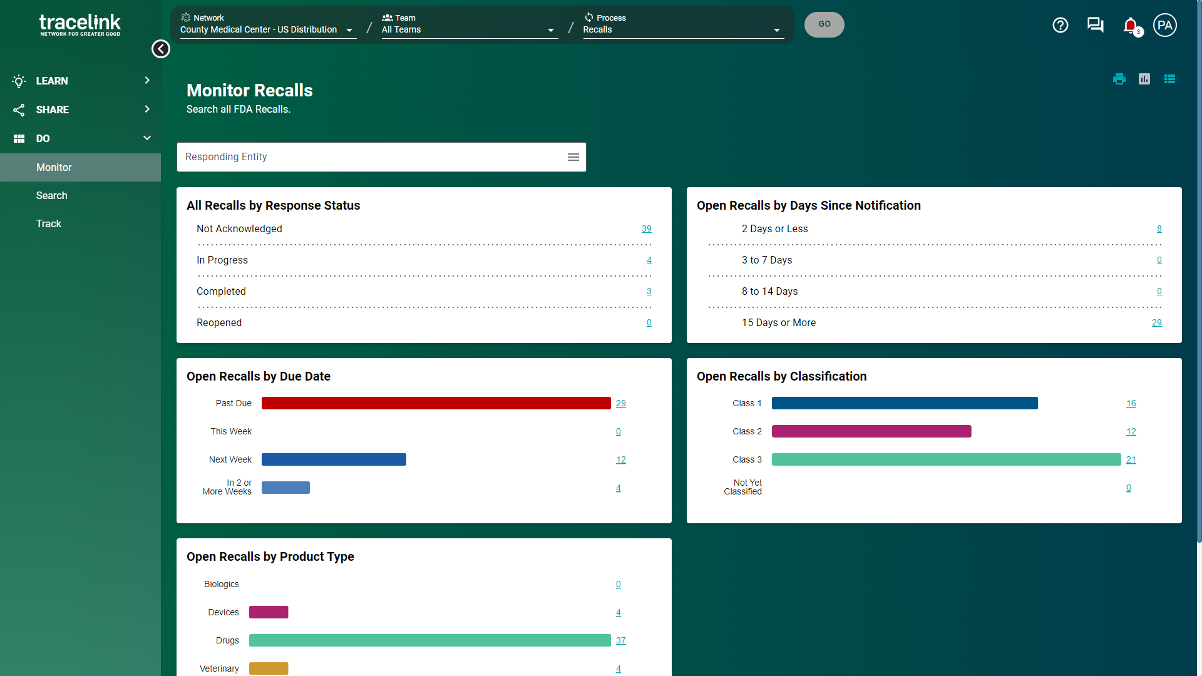
Automated in-app and email reminders
Visibility across the organization
Clickable to see underlying records
Notes:
Some of the functionality is managed directly by the Opus platform on which Digital Recalls is built. That includes elements around navigation, notifications and email alerts.
Your users will get email notifications on alerts such as when a new recall notice is published, when an existing recall is updated by FDA or the recalling company, if a response is overdue, perhaps if a teammate adds a comment to a recall.
features include
automatic in-app notifications and email reminders,
executive-level visibility to the status of recalls across the organization and the ability to
navigate into specific categories on the dashboard
Do you have a recall coordinator or persons who are in charge of coordinating the recalls process in your facilities?
What kind of visibility do you have today about recalls across locations?

Slide 28
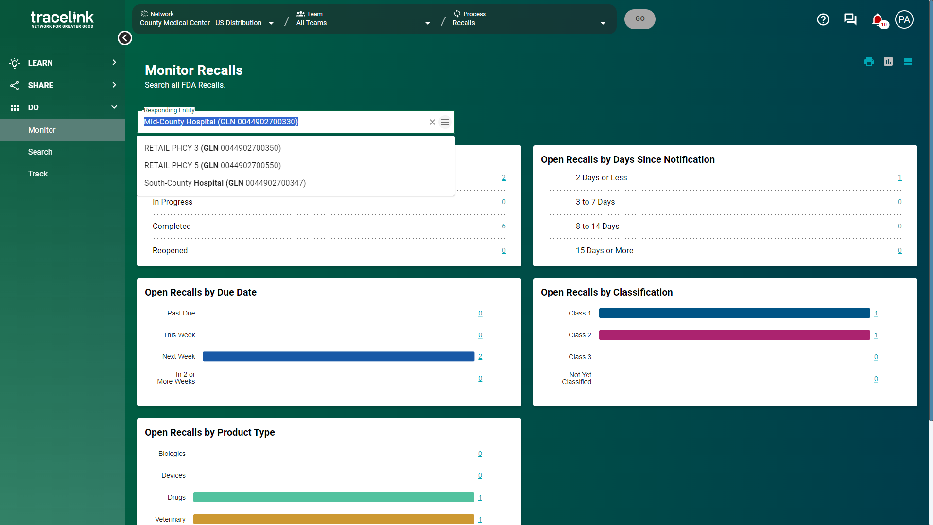
Filter by locations
Notes:
If you like, you can give users permissions to filter the dashboard by locations, this is important for companies that have floaters who are responsible for getting product from multiple locations.
Can you tell me about any floaters you may have? (how many? How are they assigned? How do they keep track and report back today?)

Slide 29
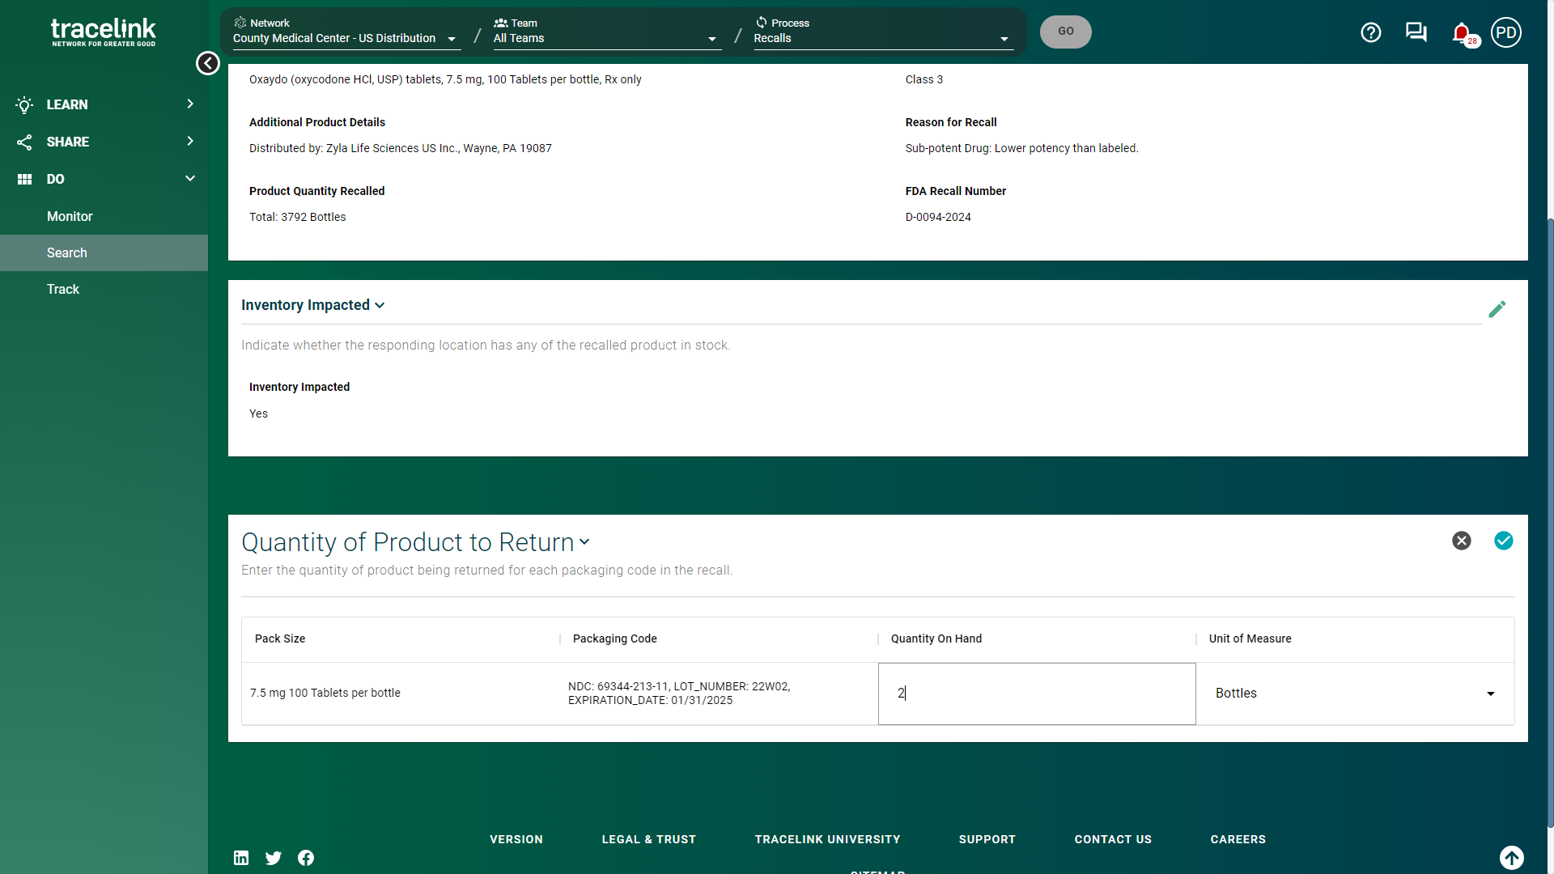
Does the location have inventory?
How much was pulled?
Notes:
Each location will have the ability to acknowledge a recall, let you know if they found inventory and report back the quantity
Do you have staff (who?) who first look up buying data or in your inventory software to see if you have purchased this impacted NDC (or NDC and lots) – and then opt out of recall if you haven’t purchased this NDC (or lots)? Or do you go straight to walking the shelves?
Who is responsible, in the pharmacy, for walking the shelves and pulling product on your team? Pharmacists? Pharmacy Techs? Buyers?
Who is responsible in other areas, i.e., on the patient floors, dispensing cabinets, treatment rooms?
Walking the shelves outside of the pharmacy takes up the most time in the recalls process, so knowing who performs this task is important.

Slide 30
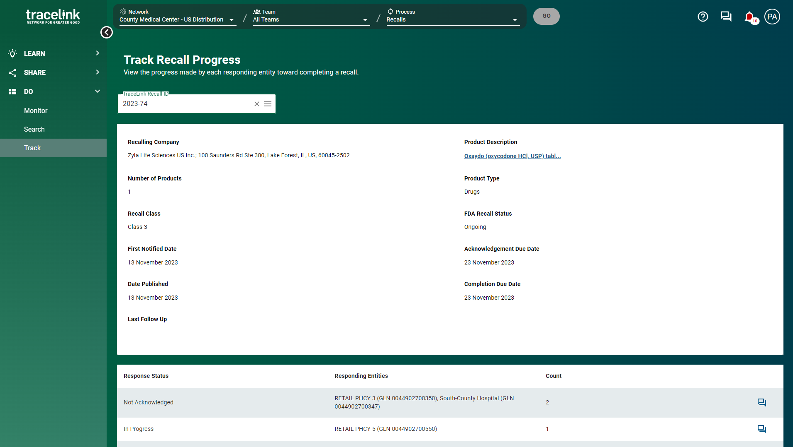
Quickly follow up with all locations in a stage
Notes:
For each recall, you get a summary screen where you can send notifications to locations that are behind.
How do you check in with your locations about a specific recall today?
Do you have SLA’s in place for your recall process?

Slide 31
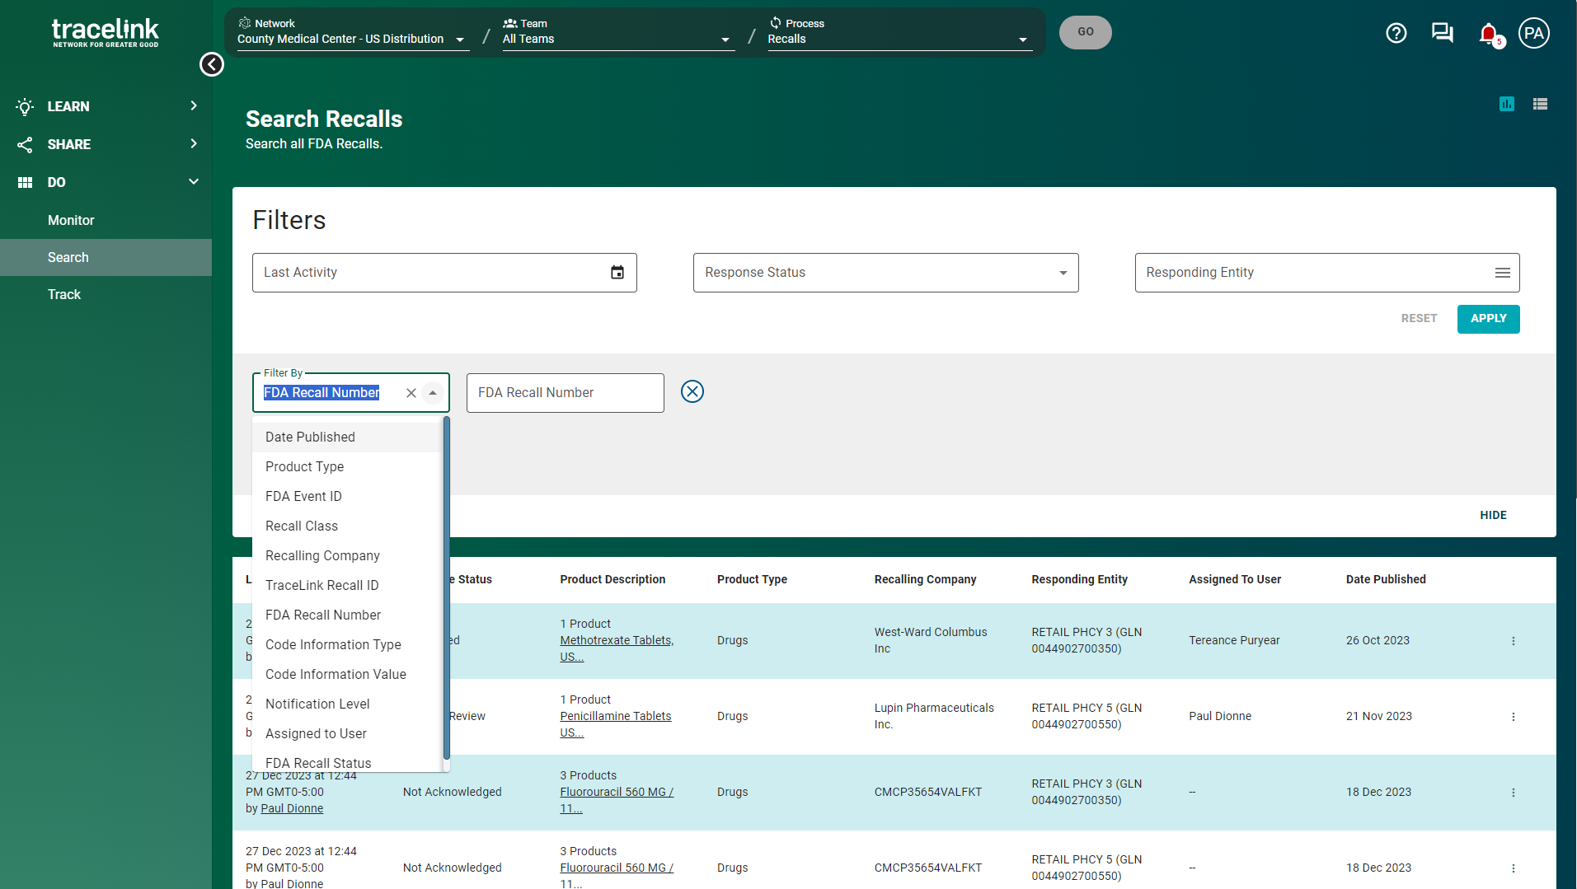
Recalls are in a searchable, easy to read data-driven format
Notes:
Recalls are in a searchable, easy to read, data-driven format.

Slide 32
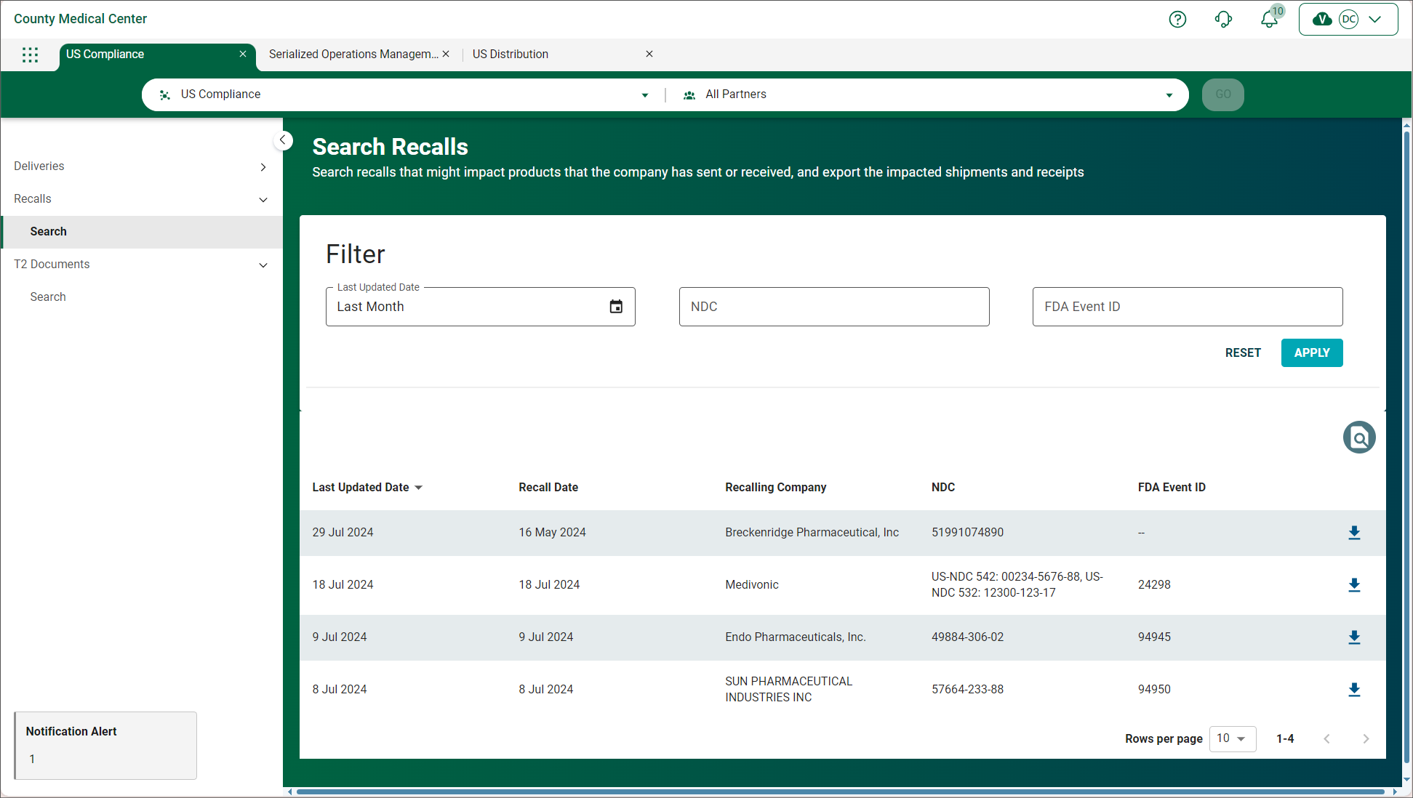
Identify Received Compliance Data for Product Impacted by a Recall
When recall notifications are issued by the FDA, US Compliance receives recall notice information and provides details of recalls that might impact product that your company has sent or received.

Slide 33
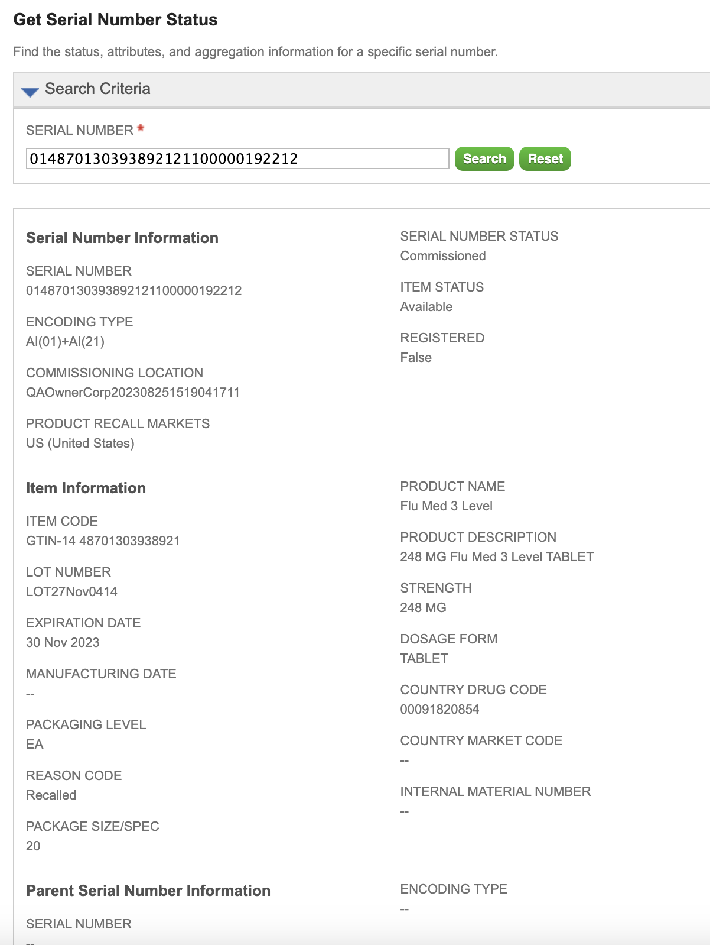
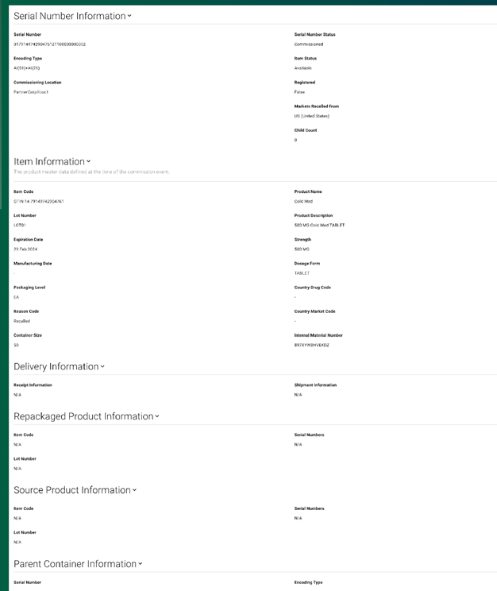
Impacted Product is Automatically Marked
Notes:
TL solution will prevent SOM Shipment of product marked as “Recalled”

